Slide 1
Salmon Population Statistics and Trends
United States Northwest

Slide 2
Valuable Components of The Dataset
Taken from Column Definitions in Spreadsheet
Common Population Name: name of population as people may commonly refer to it.
ESU Name: a group of Pacific salmon or steelhead trout that is (1) substantially reproductively isolated from other conspecific units and (2) represents an important component of the evolutionary legacy of the species.
Species: The name of the species that the population belongs to.
Start/End Year: The earliest/latest year that viable salmonid population statistics are reported for this population.
Number of Spawners: The total number of fish returning to spawn in the data collection year.
Age 1-7 Returns: The fraction of fish who are defined as having an age of 1-7 that returned to spawn each year.

Slide 3
Limitations of The Data
There are a few columns with missing values including Natural Spawners with Jacks, Natural Spawners Excluding Jacks, Total Spawners with Jacks, Jack Fraction of Hatchery Spawners, and others, so it will be difficult to compare those columns to those with complete data.
Jacks refer to male salmon that mature faster than their female counterparts (Janes) so this data is not important to the overall spawn rates of salmon since one Jack can fertilize many eggs from Janes.
The data is limited the Northwest population but is divided into four regions and species counts for more detailed investigation.

Slide 4
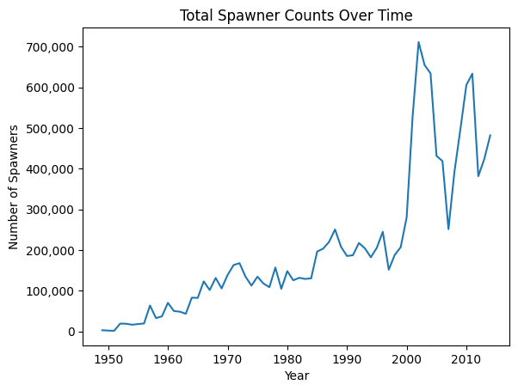
Total Salmon Population
Fluctuation in more recent measures but overall trending upward with the max population occurring in 2002 with 711,555 spawners in total.

Slide 5
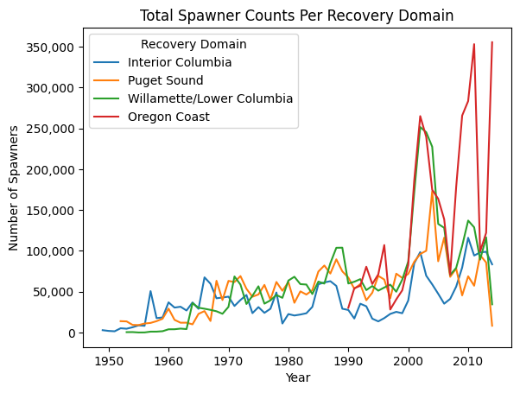
Spawner Counts Per Region
Oregon has the largest population but only started recording data in 1990. Semi-consistent population with recent spikes in 2002 and 2014.

Slide 6
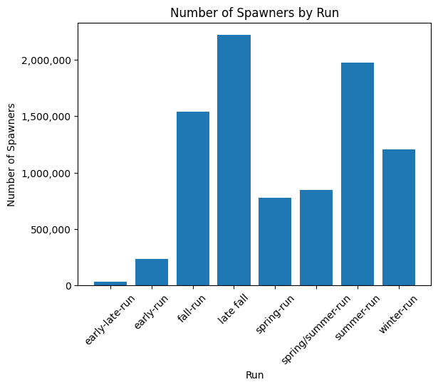
Spawners Per Run
The number of spawners per season in each region. Some columns like “early-late-run” don’t make much sense but most notable spikes are in the summer and late fall runs.

Slide 7
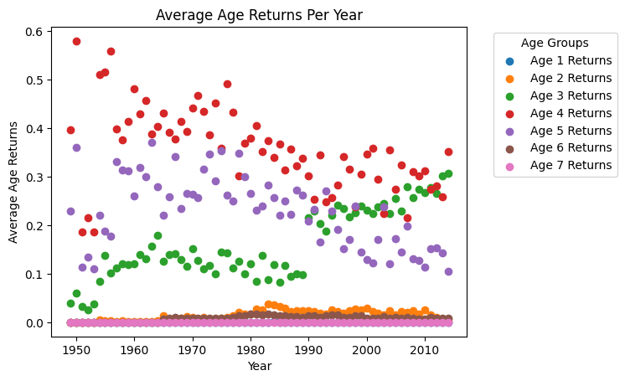
Age Returns Per Year
The highest age returns over this time series data is Age 4 with the lowest being Age 7.

Slide 8
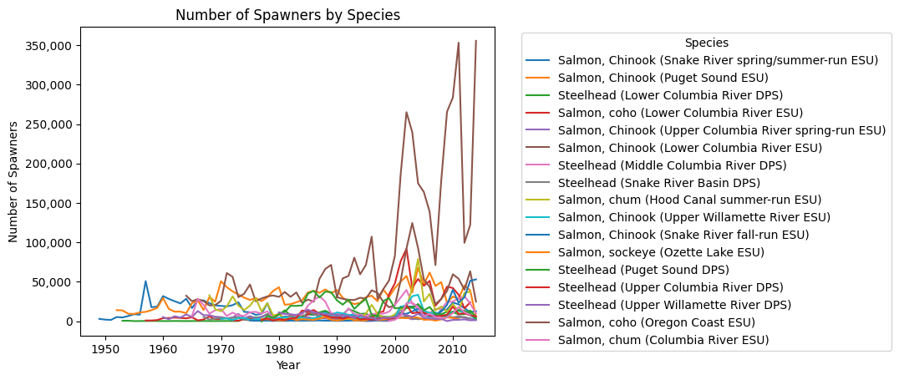
Number of Spawners by Species
Small amount of spawners for most salmon species but notably Coho Salmon from the Oregon Coast has a significantly large population especially more recently.

Slide 9
Takeaways from the Data
Salmon populations in the US Northwest are growing over time as opposed to declining as previously thought.
The Oregon Coast has the most significant population among the Regions in this dataset with Coho Salmon being the most abundant.
Age 4 Spawners return the most and Late Fall and Summer have the most returns.
All in all, salmon populations in the Northwest are on the rise and it seems conservation efforts have been successful in the last 70 years.

